Slide 1

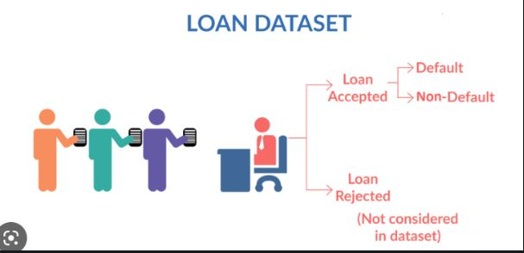
Mini-Project :Python
TITLE :Loan Dataset
Submitted by :
Rohit Dudmal
Shubham Rajput
Parul Bhaiya
Shachi Vaidya
Rupal Sanjay Nikum

Slide 2
Problem Definition
Dataset:
It contains the complete loan data for all loans issued through the time period 2007 to 2011.
Problem Statement :
Loans dataset aims to identify variables which indicate if a person is likely to default, which can be used for identifying the risky loan applicants to avoid any financial loss to the company.

Slide 3
Data Set Description
1.annual_inc - The self-reported annual income provided by the borrower during registration.
2.dti - A ratio calculated using the borrower’s total monthly debt payments on the total debt obligations, excluding mortgage and the requested LC loan, divided by the borrower’s self-reported monthly income.
3.emp_length -Employment length in years. Possible values are between 0 and 10 where 0 means less than one year and 10 means ten or more years.
4.funded_amnt - The total amount committed to that loan at that point in time.
5.funded_amnt_inv -The total amount committed by investors for that loan at that point in time.
6.grade - LC assigned loan grade
7.id - A unique LC assigned ID for the loan listing.
8.installment - The monthly payment owed by the borrower if the loan originates.

Slide 4
Data Set Description
9.int_rate - Interest Rate on the loan
10.last_pymnt_amnt-Last total payment amount received
11.last_pymnt_d -Last month payment was received
12.loan_amnt -The listed amount of the loan applied for by the borrower. If at some point in time, the credit department reduces the loan amount, then it will be reflected in this value.
13.loan_status - Current status of the loan
14.member_id -A unique LC assigned Id for the borrower member.
15.purpose - A category provided by the borrower for the loan request.
16.term -The number of payments on the loan. Values are in months and can be either 36 or 60.

Slide 5
Data Set Description
17.total_acc -The total number of credit lines currently in the borrower's credit file
18.total_pymnt -Payments received to date for total amount funded
19.total_pymnt_inv -Payments received to date for portion of total amount funded by investors
20.total_rec_int -Interest received to date

Slide 6
Business Importance of Problem
LendingClub is the largest online loan marketplace, facilitating personal loans, business loans, and financing of medical procedures. Borrowers can easily access lower interest rate loans through a fast online interface.
Like most other lending companies, lending loans to ‘risky’ applicants is the largest source of financial loss (called credit loss). The credit loss is the amount of money lost by the lender when the borrower refuses to pay or runs away with the money owed. In other words, borrowers who default cause the largest amount of loss to the lenders. In this case, the customers labelled as 'charged-off' are the 'defaulters'.
If one is able to identify these risky loan applicants, then such loans can be reduced thereby cutting down the amount of credit loss.
In other words, the company wants to understand the driving factors (or driver variables) behind loan default, i.e. the variables which are strong indicators of default. The company can utilise this knowledge for its portfolio and risk assessment.
To develop your understanding of the domain, you are advised to independently research a little about risk analytics (understanding the types of variables and their significance should be enough).

Slide 7
Project Flow – Question 1
1. Import the dataset and understand it.
To read the dataset we use pandas function pd.read_csv()
and provide the path for location where the file is stored.
Code :

Slide 8
Project Flow – Question 2
2.List down the number of rows and columns.
For listing down rows and columns we use pandas function as pd.shape which return values as (rows_no,columns_no).
Code:
Column count
Row count

Slide 9
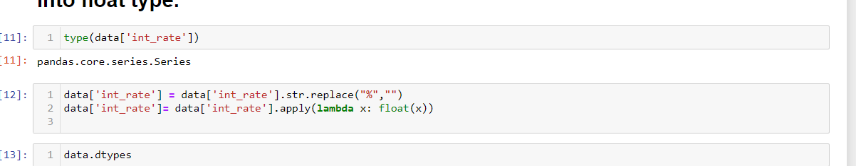
Project Flow – Question 3
3. ‘Int_rate’ column is character type. With the help of lambda function. convert into float type.
First we check datatype of int_rate column using data.dtypes
So datatype of int_rate is ‘ Object’
As int_rate column contains values with % sign .First we have to replace that ‘%’ sign with blank_space.
Then apply lambda function to change int_rate to float.
Code:

Slide 10
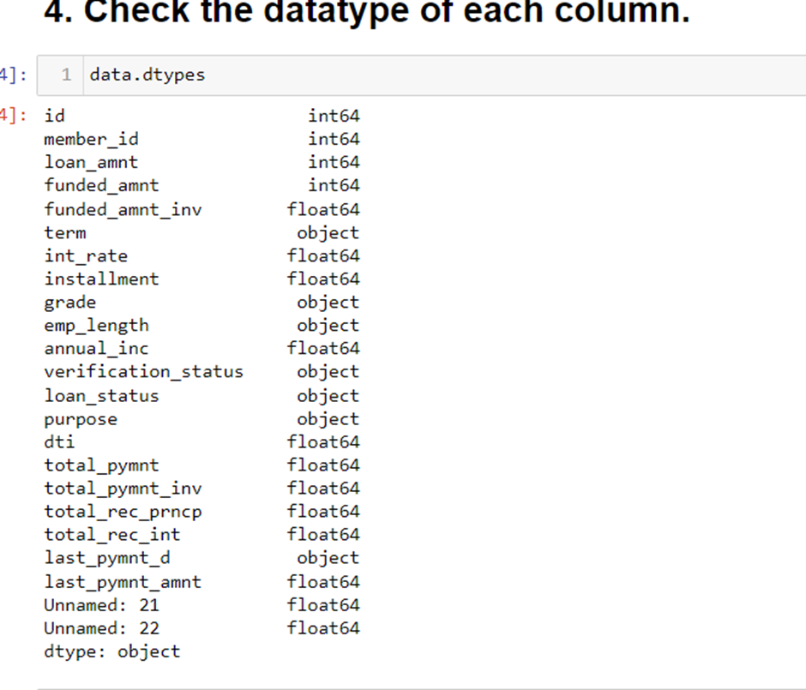
Project Flow – Question 4
4.Check the datatype of each column.
For checking datatypes of each column we use data.dtypes
Code:

Slide 11
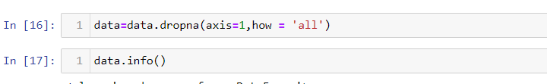
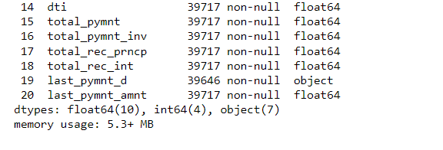
Project Flow – Question 5
5.Cleaning the dataset- Remove the columns having complete NaN value in the entire dataset .
First we will check which columns contain all null values
Code:

Slide 12
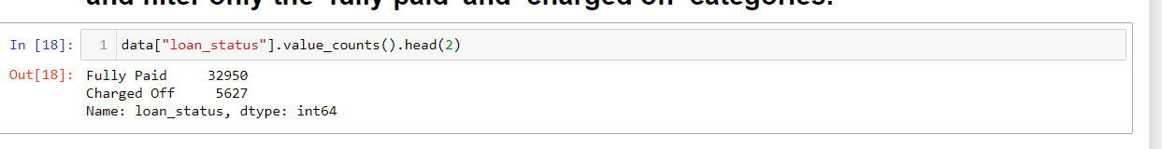
Project Flow – Question 6
6. Write the code to find the value counts of the ‘loan_status’ category. column and filter only the ‘fully paid’ and ‘charged off’ categories.
For reading values counts from particular department we use value_counts .
It return values of Loan_status which give Fully_paid and Charged_off count.
Code:

Slide 13
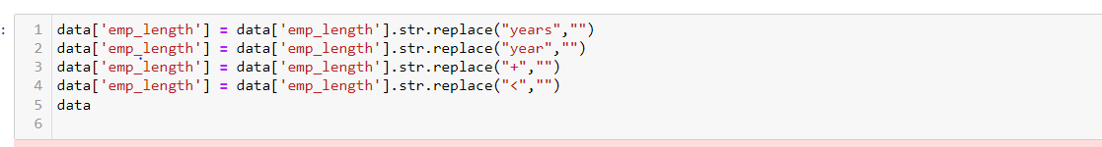
Project Flow – Question 7
7. Filter the ‘Emp_Len’ column to extract the numerical value from the string.
Here we use .replace function to replace .years,year,+.< .
After replacing this we get the numerical data from emp_len column.
Code:

Slide 14
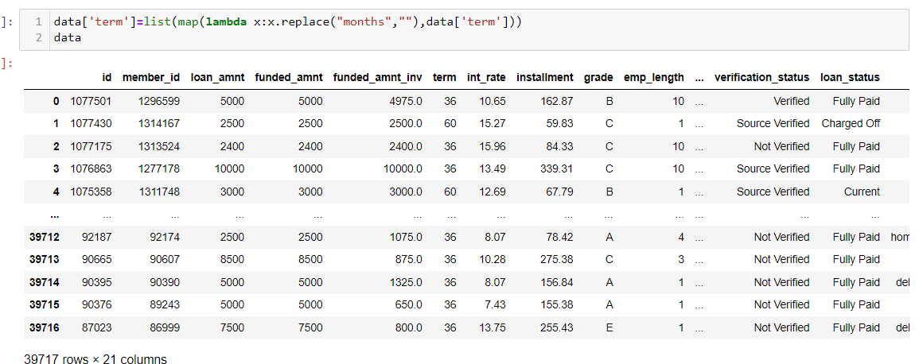
Project Flow – Question 8
8.Using the Lambda function, remove the month from the ‘term’ column such that ‘36 months’, ‘60 months’ appear as 36 and 60 respectively.
We going to use replace along with lambda function to separate 36 from months.
Code:

Slide 15
Project Flow – Question 9
9. Create a new column as risky_loan_applicant by comparing loan_amnt and funded_amnt with the following criteria -
If loan_amnt is less than equals to funded_amnt set it as ‘0’ else set it as‘1’.
Code:

Slide 16
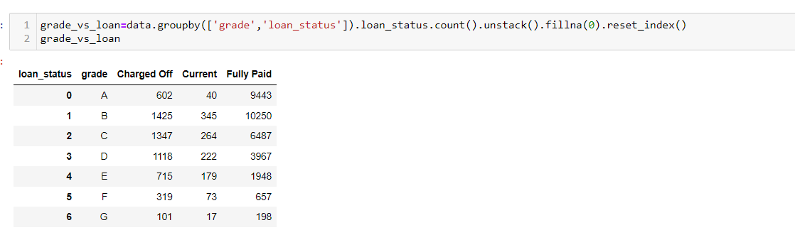
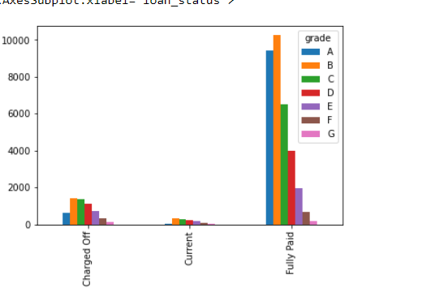
Project Flow – Question 10
10. Using the bar plot visualize the loan_status column against categorical.column grade, term, verification_status . Write the observation from each graph.
Loan_status vs Grade
First we group by loan_status and grades columns to get count of people.
Then will apply bar chart to get categories in which max defaulter are in.
Code:

Slide 17
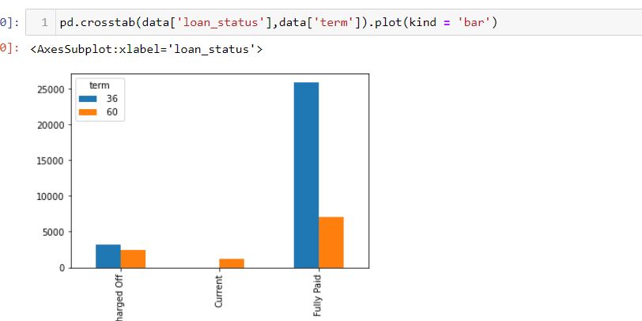
Project Flow – Question 10
2] plot term vs Loan_status
Code:

Slide 18
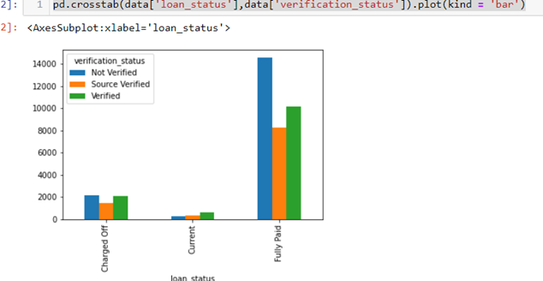
Project Flow – Question 10
3]Verification status vs Loan_status
Code:
1.There are more number of people with grade B. Defaulter rate is high with the grade.
2. In the given dataset, we are having more number of people with term 36 months than 60 months.But The probability of loan getting defaulted is more for 60 months than 30 months.
3. In the given data ,There are more records for which the ststus is non verified. and the defaulter rate is more for non-verified status

Slide 19
Project Flow – Question 11
11.Using a user defined function convert the ‘emp_len’ column into categorical column as follows –
If emp_len is less than equals to 1 then recode as ‘fresher’.
If emp_len is greater than 1 and less than 3 then recode as ‘junior’.
If emp_len is greater than 3 and less than 7 then recode as ‘senior’
If emp_len is greater than 7 then recode as ‘expert’.

Slide 20
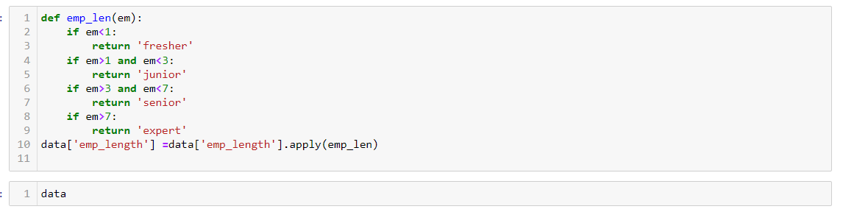
Project Flow – Question 11
Here we use user defined function .
Before that we have to separate the emp_len column
By numeric data using replace function.

Slide 21
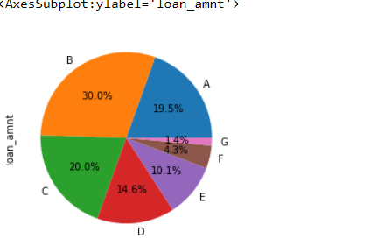
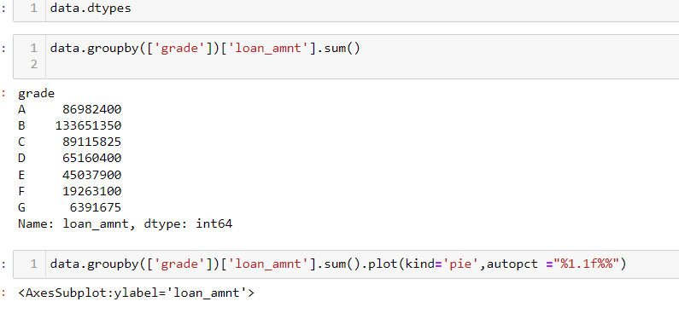
Project Flow – Question 12
12.Find the sum of ‘loan_amnt’ for each grade and display the distribution of ‘loan_amnt’ using a pie plot
As joining two columns use of group by is essential.
Then apply pie plot to display loan_amount as per each grade.

Slide 22
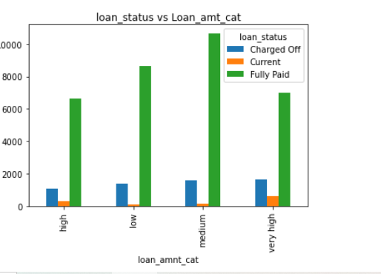
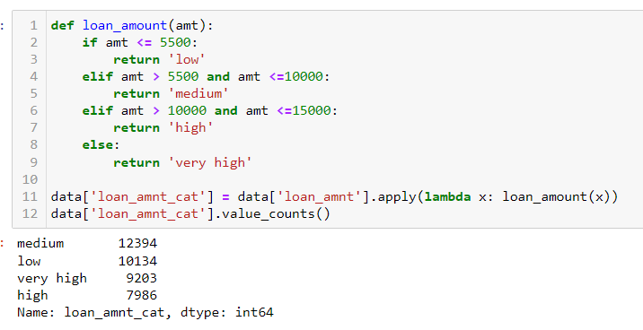
Major Challenge
1]Divide Loan amount into groups based on intervals and plot the graph against loan_status.
In dataset loan_amount have various intevals .
We applied function to convert that numerical data into categories .
Plotted those 4 categories against the loan_status .

Slide 23
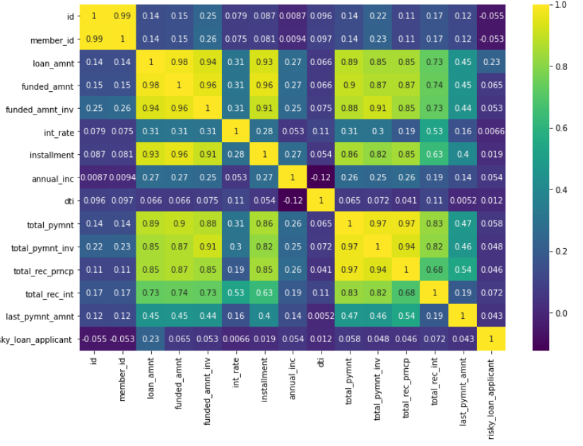

Major Challenge
2]Preparing a heatmap ,and finding out variables with highest and lowest correlations

Slide 24
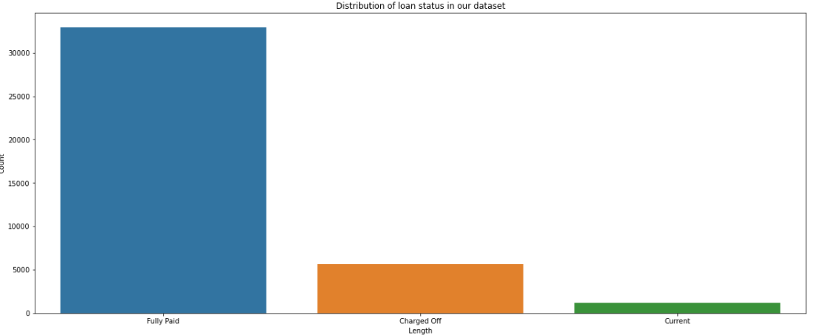
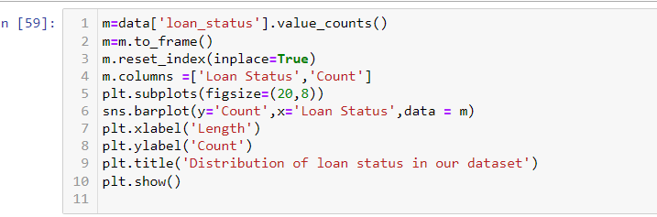
Major Challenge
3]Distribution of loan status values

Slide 25
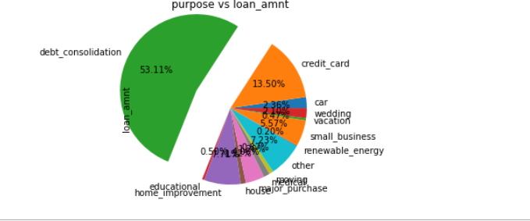
Major Challenge
4]Find out Purpose for which max amount is taken as Loan.

Slide 26
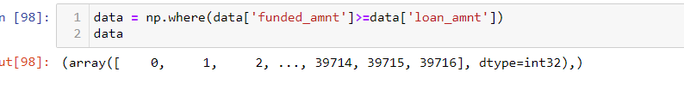
Major Challenge
Find the ids of safe loan_applicant.

Slide 27
Conclusions
Customer Bank Loan data, is a collection of values, wherein the complete data has been provided with reference to the bank data and specifically relates to loan dataset. Identification of risky loan applicants, and cutting down the amount of credit loss is the main aim of our project.
Along with this, comparing data values with other numerical data types to effectively state the most likely features that will help us derive to a set of conclusions and provide inferences according to that is the aim. This way, the bank won’t lose potential customers and also at the same time derive conclusions on the risky loan applicants and take according measures to reduce financial barriers and credit risks for the bank.
Being in the shoes of a Data Scientist, our aim was to provide with effective inferences and conclusions based on previous customer data and provide analysis on predicting conclusions on whether a customer is likely to default a loan or not. Here we used skills such as:
1.Numpy functions
2.Pandas functions
3. Visualization techniques such as : Barplot, pieplot with all their attributes.
4. Various visualization libraries like matplotlib, seaborn and plotly.

Slide 28
Thank You !!!....

